Slide 1
JVM Architecture:
Virtual Machine:
It is a software simulation of a machine which can perform operation like a physical machine .
There are two kinds of virtual machine
I . Hardware-based | system-based VM
Application-based | process- based VM
Hardware based | System-based VM
It provides several logical systems in the same computer with strong isolation from eachother. i.e. On one physical machine we are defining multiple logical machine
The main advantage of hardware based VM is Hardware resources sharing and improves the utilization of hardware resources. E.g. KVM (Kernel- based VM) for linux systems, VM ware, Xen and cloud computing.
Application-Based | Process-based VM
These VM acts as Runtime Engines to run a particular programming language application . JVM(Java VM) acts as Runtime Engine to run java based application , PVM(Parrot VM) acts as Runtime Engine to run perl based application ,CLR (Common Language Runtime) acts as Runtime engine to run .NET based application .

Slide 2
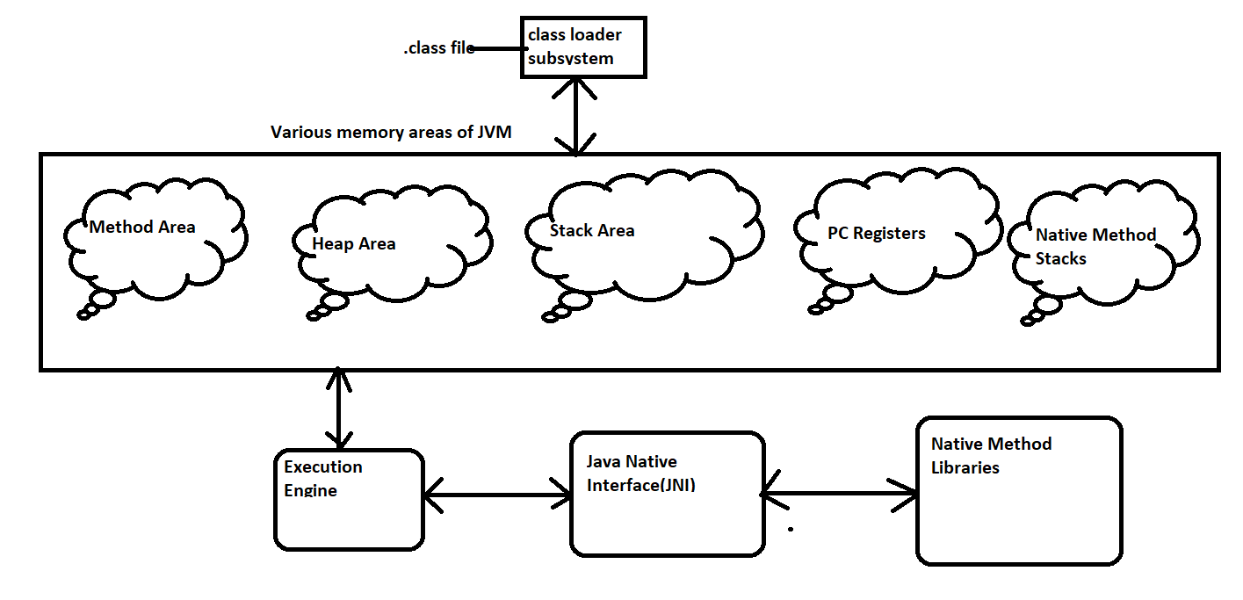
JVM is a part of JRE and it is responsible to load and run java class files.
Basic architecture diagram of JVM

Slide 3
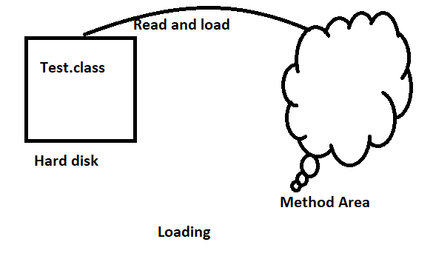
Class Loader Subsystem
Class loader subsystem is responsible for following three activities :
Loading
Linking
Initialization.
Loading
Loading means reading class files and store corresponding binary data in method area . For each class file JVM will store corresponding information in method area .
Fully qualified name of class
Fully Qualified name of parent class.
Methods Information
Variables Information
Constructors information
Modifiers Information.
Constants pool Information.

Slide 4
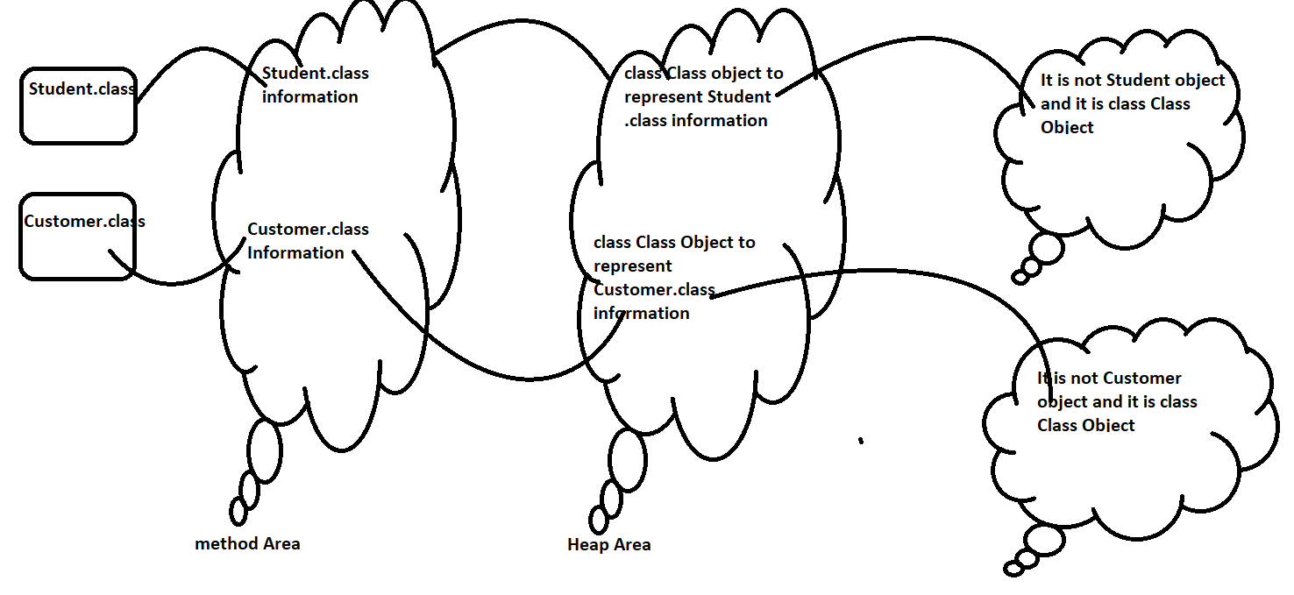
After loading .class file immediately JVM creates an Object for the loaded class in the Heap Memory of type Java.lang.Class

Slide 5
The class Class Object can be used by programmer to get class level information like methods information , variables information,constructors information etc..
import java.lang.reflect.*;
class Student{
public String getName(){
return null;
}
public int getRollNo(){
return 10;
}
}
class Test{
public static void main(String[] args)throws Exception{
Class c = Class.forName("Student"); // java.lang.String|Object
Method[] m = c.getDeclaredMethods();
int count = 0;
for(Method m1:m){
count++;
System.out.print(m1.getName()+" " );
}
System.out.println("\n The Number of of methods are: "+count);
}
}

Slide 6

For Every loaded type only one Class Object will be created eventhough we are using class multiple times in our program .
// Example
class Student{
public String getName(){
return null;
}
public int getRollNo(){
return 10;
}
}
class Test{
public static void main(String[] args)throws Exception{
Student s1 = new Student();
Class c1 = s1.getClass();
Student s2 = new Student();
Class c2 = s2.getClass();
System.out.println(c1.hashCode());
System.out.println(c2.hashCode());
System.out.println(c1==c2);
}
}

Slide 7
In the above program eventhough we are using student class multiple times only one class Class object got created .
2.Linking
Linking consists of three activities verify , prepare and resolve .
Verification
It is the process of ensuring that binary representation of a class is structurally correct or not . JVM will check whether the .class file generated by valid compiler or not . Ie. The .class file is properly formatted or not . Internally Bytecode verifier is responsible for this activity .
ByteCode verifier is a part of classloader subsystem .
If Verification fails then we will get Runtime Exception saying java.lang.VerifyError.
2.Preparation:
In this phase JVM will allocate memory for class level static variable and assign default values .
In Initialisation phase original values will be assigned to the static variables . And here only default values will be assigned .

Slide 8
3.Resolution | | Resolve
It is the process of replacing symbolic name in our program with original memory references from method area .
class Test{
public static void main(String[] args){
String s = new String(“Akhil Kumar”);
Student s1 = new Student();
}
}
For the above class class loader loads Test.class,String.class, Student.class and Object.class
The names of these classes are stored in constant pool of Test class in Resolution phase these names will be replaced with original memory references from method area .

Slide 9
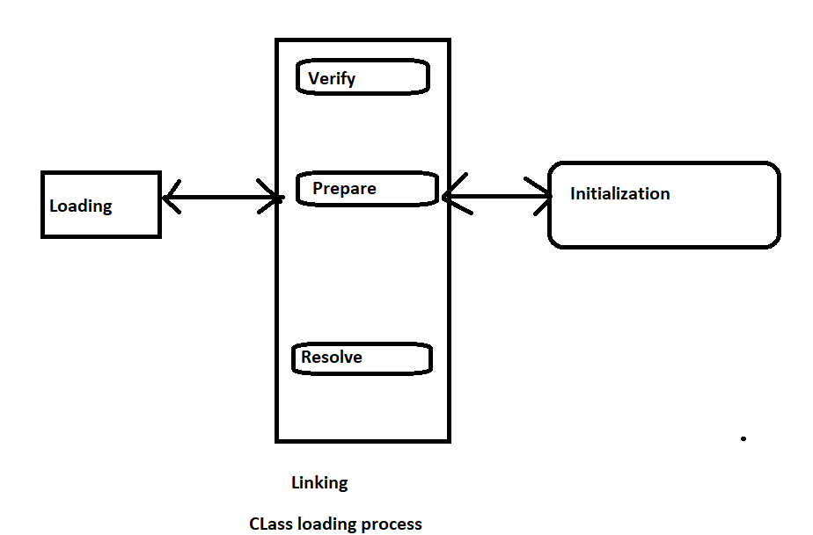
3.Initialization:
In this all static variables are assigned with original values and static blocks will be executed from parent to child and from top to bottom.

Slide 10
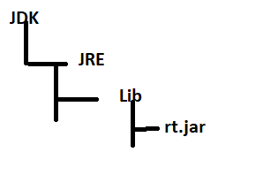
Note:
While loading linking and Initialization if any error occurs then we will get Runtime exception saying java.lang.linkage error .
Types of Class Loaders :
Class loader subsystem contains the following three types class loaders .
Bootstrap class loader | primodial class loader
Extension class loader
Application class loader | System class loader .
Bootstrap class loader | primodial class loader
It is responsible to load core java api classes i.e. the classes present in rt.jar
Jdk\jre\lib this location is called Bootstrap class path i.e Bootstrap classloader is responsible to load classes from bootstrap classpath .
Bootstrap class loader is by default available with every JVM . It is Implemented in native languages like c and c++ and is not implemented in java

Slide 11
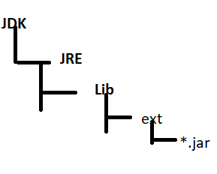
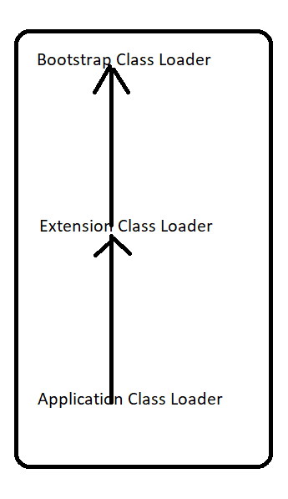
Extension Class Loader:
Extension class loader is the child class of bootstrap class loader
Extension class loader is responsible to load classes from extension class path jdk\jre\lib\ext \*.jar
Extension class loader is implemented in java and the corresponding .class file is
Sun.misc.Launcher$ExtClassLoader.class
Application Class Loader | System Class Loader
Application class loader is the child class of Extension class loader
This class loader is responsible to load classes from application classpath . It internally uses environment variable classpath .
Application class Loader is implemented in java and the corresponding .class file name is
Sun.misc.Launcher$AppClasssLoader.class

Slide 12
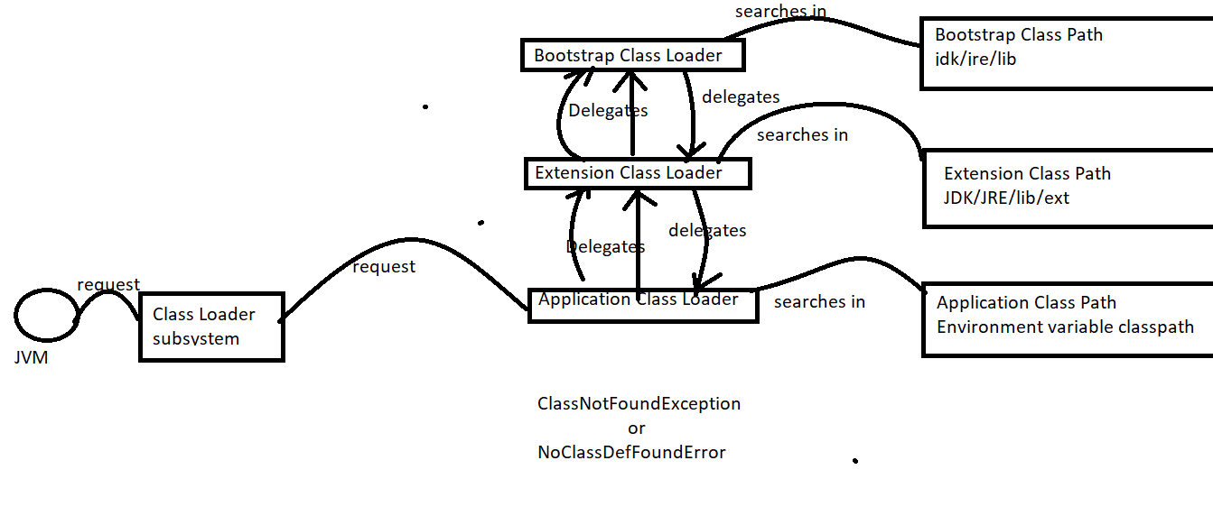
How class Loader works :

Slide 13
How class Loader works :
Class loader follows delegation hierarchy principle . Whenever JVM come across a particular class first it will check whether the corresponding .class file is already loaded or not . If it is already loaded in method area then JVM will consider that loaded class . If it is not loaded then Jvm request class loader subsystem to load that particular class.
Then class loader subsystem handovers the request to application class loader .
Application class loader delegates the request to extension class loader which intern delegates the request to bootstrap class loader .
Then bootstrap class loader will search in bootstrap classpath if it is available then the corresponding .class file will be loaded by bootstrap class loader . If it is not available then bootstrap class loader delegates the request to extension class loader.
Extension class loader will search in extension class path if it is available then it will loaded otherwise extension class loader delegates the request to application class loader
Application class loader will search in application class path if it is available then it will be loaded otherwise we will get runtime error
classNotFoundException or NoClassDefFoundError.

Slide 14
Example :
Class Test{
public static void main(String[] args){
sopln(String.class.getClassLoader()); // null
sopln(Test.class.getClassLoader()); // sun.misc.Launche$AppClassLoade@1432
sopln(Customer.class.getClassLoader()); // sun.misc.Launche$ExtClassLoade@1432
}
}
// Assume Customer.class is present in both extension and application classpaths
// and Test.class present in only application classpath
For String.class
Bootstrap class loader from bootstrap class path
0 / p : null
For Test.class
Application class loader from application class path
o/p : sun.misc.Launche$AppClassLoade@1432
For Customer.class
Extension class loader from extension classpath

Slide 15
Note
Bootstrap class loader is not java object hence we got null in the first case but extensions and application class loaders are java objects hence we are getting corresponding outputs for the two sops
Class Loader subsystem will give the highest priority for bootstrap class path then extension classpath and then application class path

Slide 16
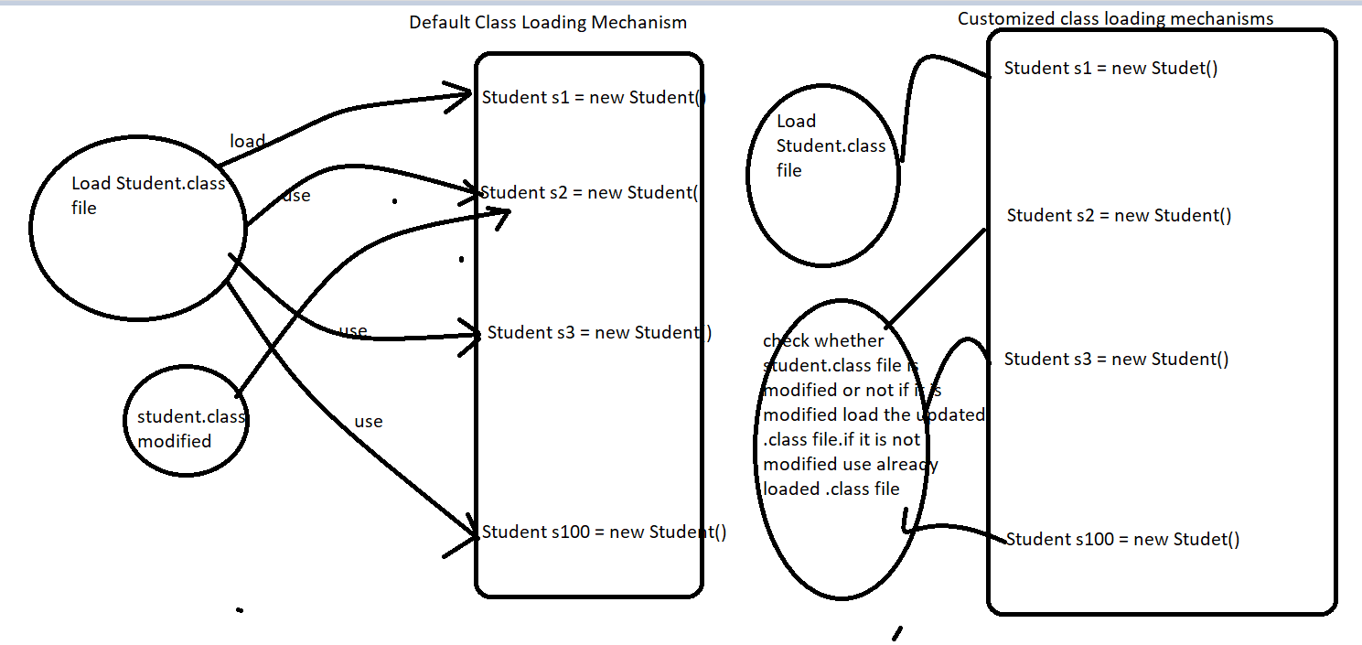
Need of customized class Loader:
Default class loaders will load .class file only once eventhough we are using that class multiple times in our program .After loading .class file if it is modified outside then default class loader won’t load updated version class file (because .class already available in method area) we can resolve this problem by defining our own class loader
The main advantage of customized class loader is we can control class loading mechanism based on our requirements.
For example . We can load .class file separately everytime so that updated version available to that program.

Slide 17
How to define Customized Class Loader:
We can define our own cutomised class loader by extending java.lang.ClassLoader class
public class CustClassLoader extends ClassLoader{
public Class loadClass(String name) throws ClassNotFoundException{
check for updates and load updated .class file and returns corresponding class
}
}
class client{
public static void main(String[] args){
Dog d1 = new Dog(); // load by default class loader
CustClassLoader cl = new CustClassLoader();
cl.loadClass("Dog"); // loaded by customized class loader
cl.loadClass("Dog");
}
}

Slide 18
Note:
While developing webservers and application servers we can go for class loader to customize class loading mechanism.
Q1
What is need of classLoader class
We can use java.lang.classLoader class to define our own customized class loader . Every class Loader in java should be child class of java.lang.ClassLoader class either directly or Indirectly . Hence this class acts as base class for all customized class Loaders

Slide 19
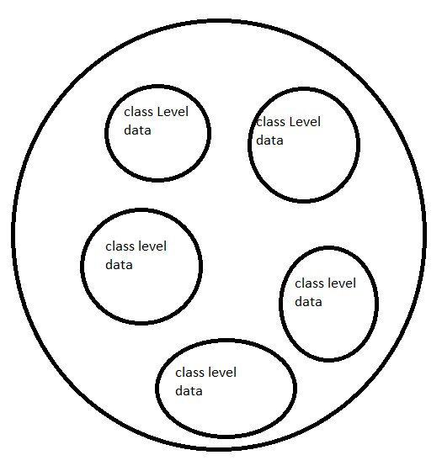
Various Memory areas present inside JVM:
Whenever jvm loads and runs a java program it needs memory to store several things like bytecode ,objects ,variables etc..
Total jvm memory organized into following five categories .
Method Area.
Heap Area .
Stack Area.
PC Registers.
Native Method Stacks .
I. Method Area
For every JVM one method area will be available
Method area will be created at the time of JVM start up .
Inside method area class level binary data including static variables will be stored .
Constant pools of a class will be stored inside method area .
Method area can be accessed by multiple threads simultaneously . Hence it I not
Thread safe .
It is not a contiguous memory

Slide 20
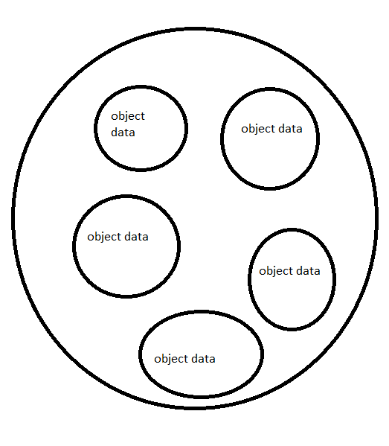
II. Heap Area
For every jvm one heap area is available .
Heap area will be created at the time of jvm startup
Objects and corresponding instance variables will be stored in the heap area. ]
Every array in java is Object only hence arrays also will be stored in the heap area .
Heap area can be accessed by multiple threads. Hence the data stored in heap memory is not thread safe .
Heap area need not be contiguous .
Program to display heap memory statistics
A java application can communicate with jvm by using Runtime object
Runtime class present in java.lang package and it is a singleton class. We can create Runtime
Object as follows .
Runtime r = Runtime.getRuntime();(once we got Runtime Object we can call following met
Hods on this object)
r.maxMemory(): It returns the no bytes of maxmemory allocated to the heap .
r.totalMemory() It returns no of bytes of totalMemory allocated to the heap . Initial
freeMemory(): It returns no. of bytes of free memory present in the heap.

Slide 21
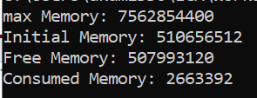
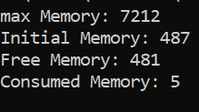
Example to demonstrate the Heap memory statistics :
class HeapDemo{
public static void main(String[] args){
Runtime r = Runtime.getRuntime();
System.out.println("max Memory: "+r.maxMemory());
System.out.println("Initial Memory: "+r.totalMemory());
System.out.println("Free Memory: "+r.freeMemory());
System.out.println("Consumed Memory: "+r.totalMemory()- r.freeMemory());
}
}

Slide 22

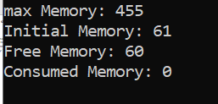
How to set minimum and maximum heap sizes ? :
Heap Memory is finite memory but based on our requirement we can set maximum and minimum heap sizes i.e we can increase or decrease the heap size based on our requirement .
We can use the following flags with java command
–Xmx: To set maximum heap size (max Memory )
Java –Xmx512m HeapDemo this command will set maximum Heap size as 512 mb
–Xms : we can use this command to set minimum heap size
Example java –Xms64m HeapDemo to set minimum heap size as 64 MB (Ie. Total memory )

Slide 23
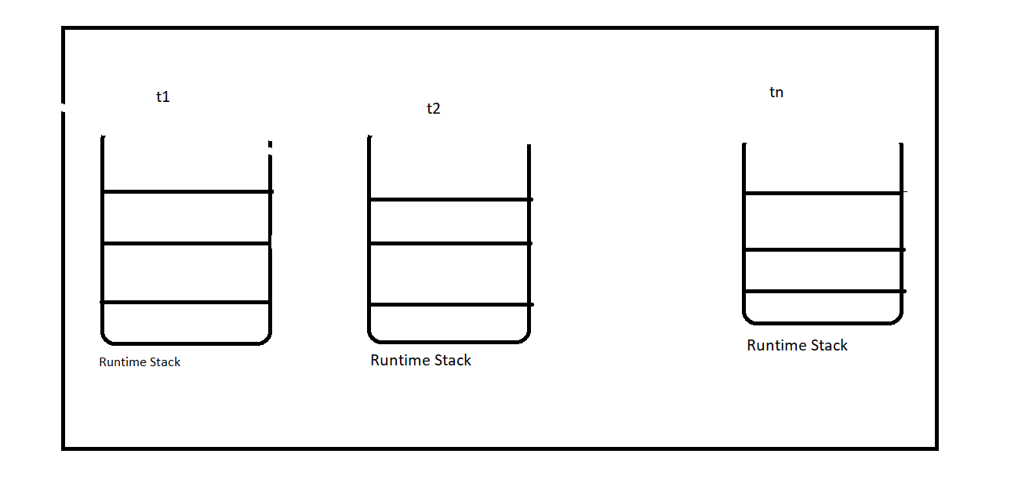
III. Stack Area
For every thread jvm will create a separate stack at the time of thread creation each and every method call performed by that thread will be stored in the stack including local variables also .
After completing a method the corresponding entry from the stack will be removed after completing all method call the stack will become empty and that empty stack will be destroyed by the jvm just before terminating the thread .
Each entry in the stack is called stack frame or activation record .
The data stored in the stack is available only for the corresponding thread and not available to the remaining thread hence this data is thread safe.

Slide 24
Stack Frame Structure :
Each stack frame contains three parts.
Local Variable Array:
It contains all parameters and local variables of the method each slot in the array is 4 bytes values of type int,float and reference occupy one entry in the array .
Values of double and long occupy two consecutive entries in the array
Byte short and char value will be converted to int type before storing and occupy one slot . But the way of storing Boolean values is varied from jvm to jvm But most of the jvm follow one slot for Boolean values .
Public void m1(int i, double d,Object o,float f){
long x;
}
int double Object float long
Local variable Array
Operand stack
Frame Data
I | d | d | o | f | x | x

Slide 25
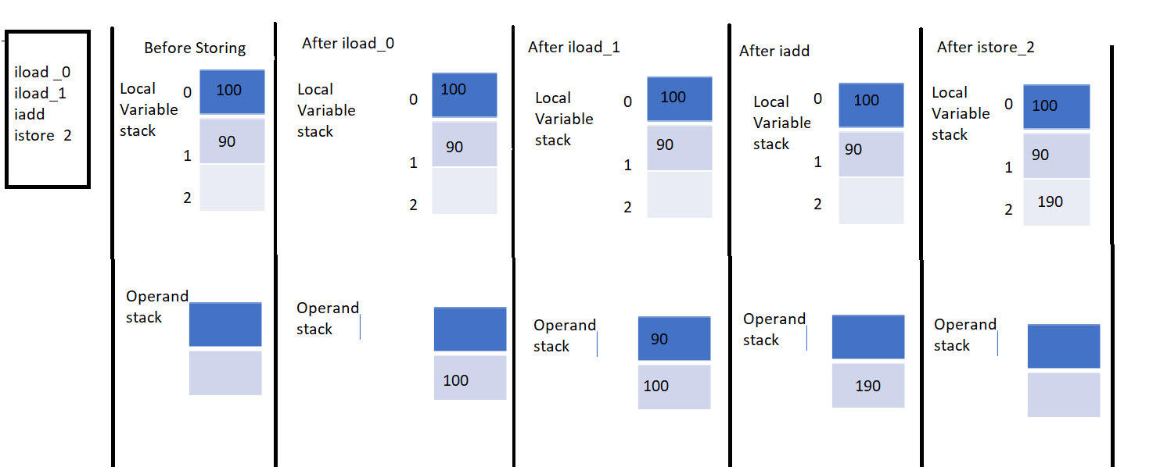
Jvm uses operand stack as workspace some instructions can push values to operand stack . And some instructions can pop values from operand stack and some instructions can perform required operation .

Slide 26
Frame Data:
Frame data contains all symbolic references related to that method it also contains reference to exception table . Which provides corresponding catch block information in the case of exceptions .
PC(Program Counter) Registers:
For every thread a separate pc register will be created at the time of thread creation pc registers contains the address of current executing instructions once instruction execution completes automatically pc register will be incremented to hold address of next instructions .
Native Method Stacks
For every thread jvm will create a separate native method stack all native method calls invoked by the threads will be stored in the corresponding native method stacks

Slide 27
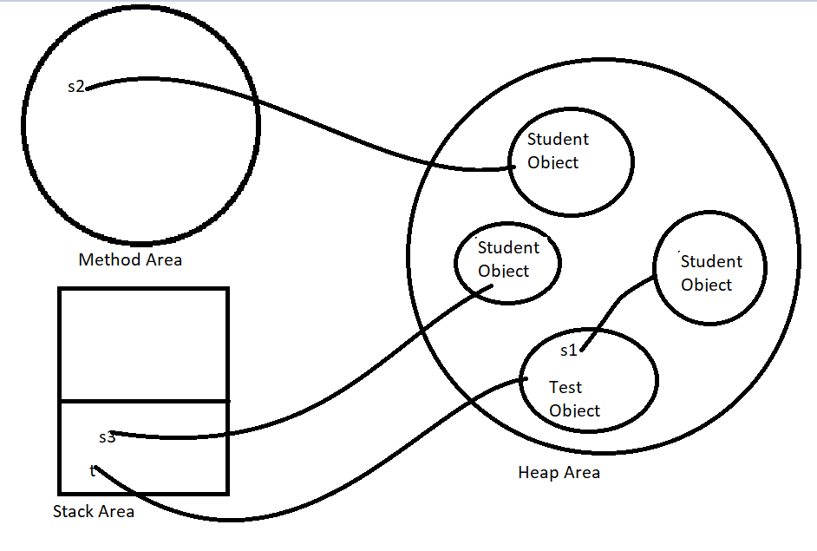
Note :
Method area , heap area and stack area are considered as important memory areas with respect to programmer .
Method area and heap area are per jvm whereas stack area pc registers and native method stack are per thread .
Static variables will be stored in method area . Instance variables will be stored in heap area . Local Variables will be stored in stack area.
class Test{
Student s1 = new Student();
static Student s2 = new Student();
public static void main(String[] args){
Test t = new Test();
Student s3 = new Student();
}
}

Slide 28
Execution Engine :
This is the central component of jvm execution engine is responsible to execute java class file .Execution engine mainly contains two components
Interpreter
JIT Compiler .
Interpreter
It is responsible to read bytecode and interpret into machine code(native code ) and execute that machine code line by line . The problem with interpreter is , It interpret everytime even same method invoked several times which reduces performance of the system . To overcome this problem sun people introduced jit compiler in 1.1 version .
II. JIT Compiler
The main purpose of JIT compiler is to improve performance .Internally JIT compiler maintains a separate count for every methods . Whenever jvm come across any method call first that method will be interpreted normally by the interpreter and the Jit compiler increments the corresponding count variable
This process will be continued for every methods once if any method count reaches threshold value then JIT compiler
identifies that that method is repeatedly used method . Such type of methods are called (Hot spot) immediately jit compiler compiles that method and generates the corresponding native code . Next time jvm come across that method call then jvm uses native code directly and executes it instead if interpreting once again so that performance of the system will be improved .Threshold count vary from jvm to jvm .

Slide 29
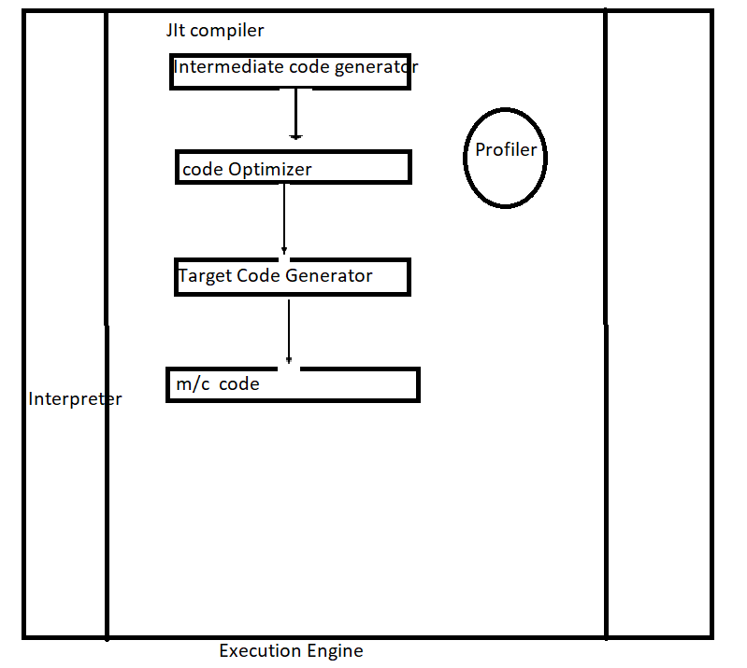
Some advanced jit compiler will recompile generated native code if count reaches threshold value second time so that nore optimized machine code will be generated.
Internally profiler , which is the part of jit compiler is responsible to identify hotspot.
Jvm interprets total program atleast once jit compilation is applicable only for repeatedly required methods not for every method.

Slide 30
Java Native Interface (JNI)
Jni acts as mediator for java method calls and corresponding native libraries ie. JNI is responsible to provide information about
Native libraries to jvm native method library holds native libraries information.

Slide 31
Class File Structure :
Class File{
magic_number;
minor_version;
major_version;
constant_pool_count;
constant_pool[];
access_flags;
this_class;
super_class;
interface_count;
interface[];
fields_count;
fields[];
methods_count;
methods[];
attributes_count;
attributes[];
}

Slide 32
Magic_Number :
The first four bytes of a class file is a magic number . This is a predefined value used by jvm to identify .class file generated by valid compiler or not .
The value should be 0xCAFEBABE
Whenever we are executing a java class if jvm unable to find valid magic number then we will get Runtime Exception saying .
Java.lang.ClassFormatError: Incompatible magic value
Minor_version and major_version:
Major and minor versions represents .class file version jvm will use these versions to identify which version of compiler generates current .class file
M.m
Major Version Minor Version
1.5 v == 49.0
1.6 v == 50.0
1.7v == 51.0
Lower versions compiler generated .class file can be run by higher version jvm but higher version compiler generated .class file can’t be run by lower version jvm if we are trying to run we will get Runtime Exception saying unsupportedClassVersionError

Slide 33
Javac 1.6 ==== java 1.7 v ==== correct
Javac 1.7v === java 1.6v == RE : UnsupportedClassVersionError
Constant_pool_count :
It represents number of constant present in constant pool .
ConstantPool[]:
It represents information about constants present in constant pool.
Access_flags:
It provides information about modifiers which are declared to the class .
This_class:
It represents fully qualified name of the class.
Super class
It represents fully qualified name of immediate super class of current class
This_class ==== Test
Super_class === Object

Slide 34
Interface count : it returns number of interfaces implemented by current class.
Interface[]: it returns interfaces information implemented by current class
Fields_count : it represent number of fields present in classs;
Fields [] : it represents fields information present in current class
Methods_count : it represent number of methods present in current class
Similarly other ……..
Javap –verbose Test.class

